Slide 1
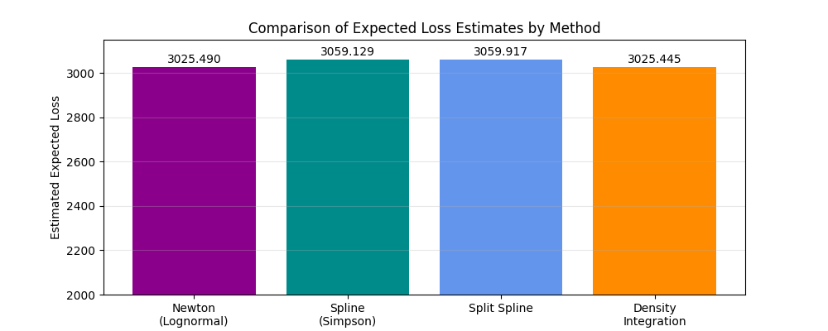
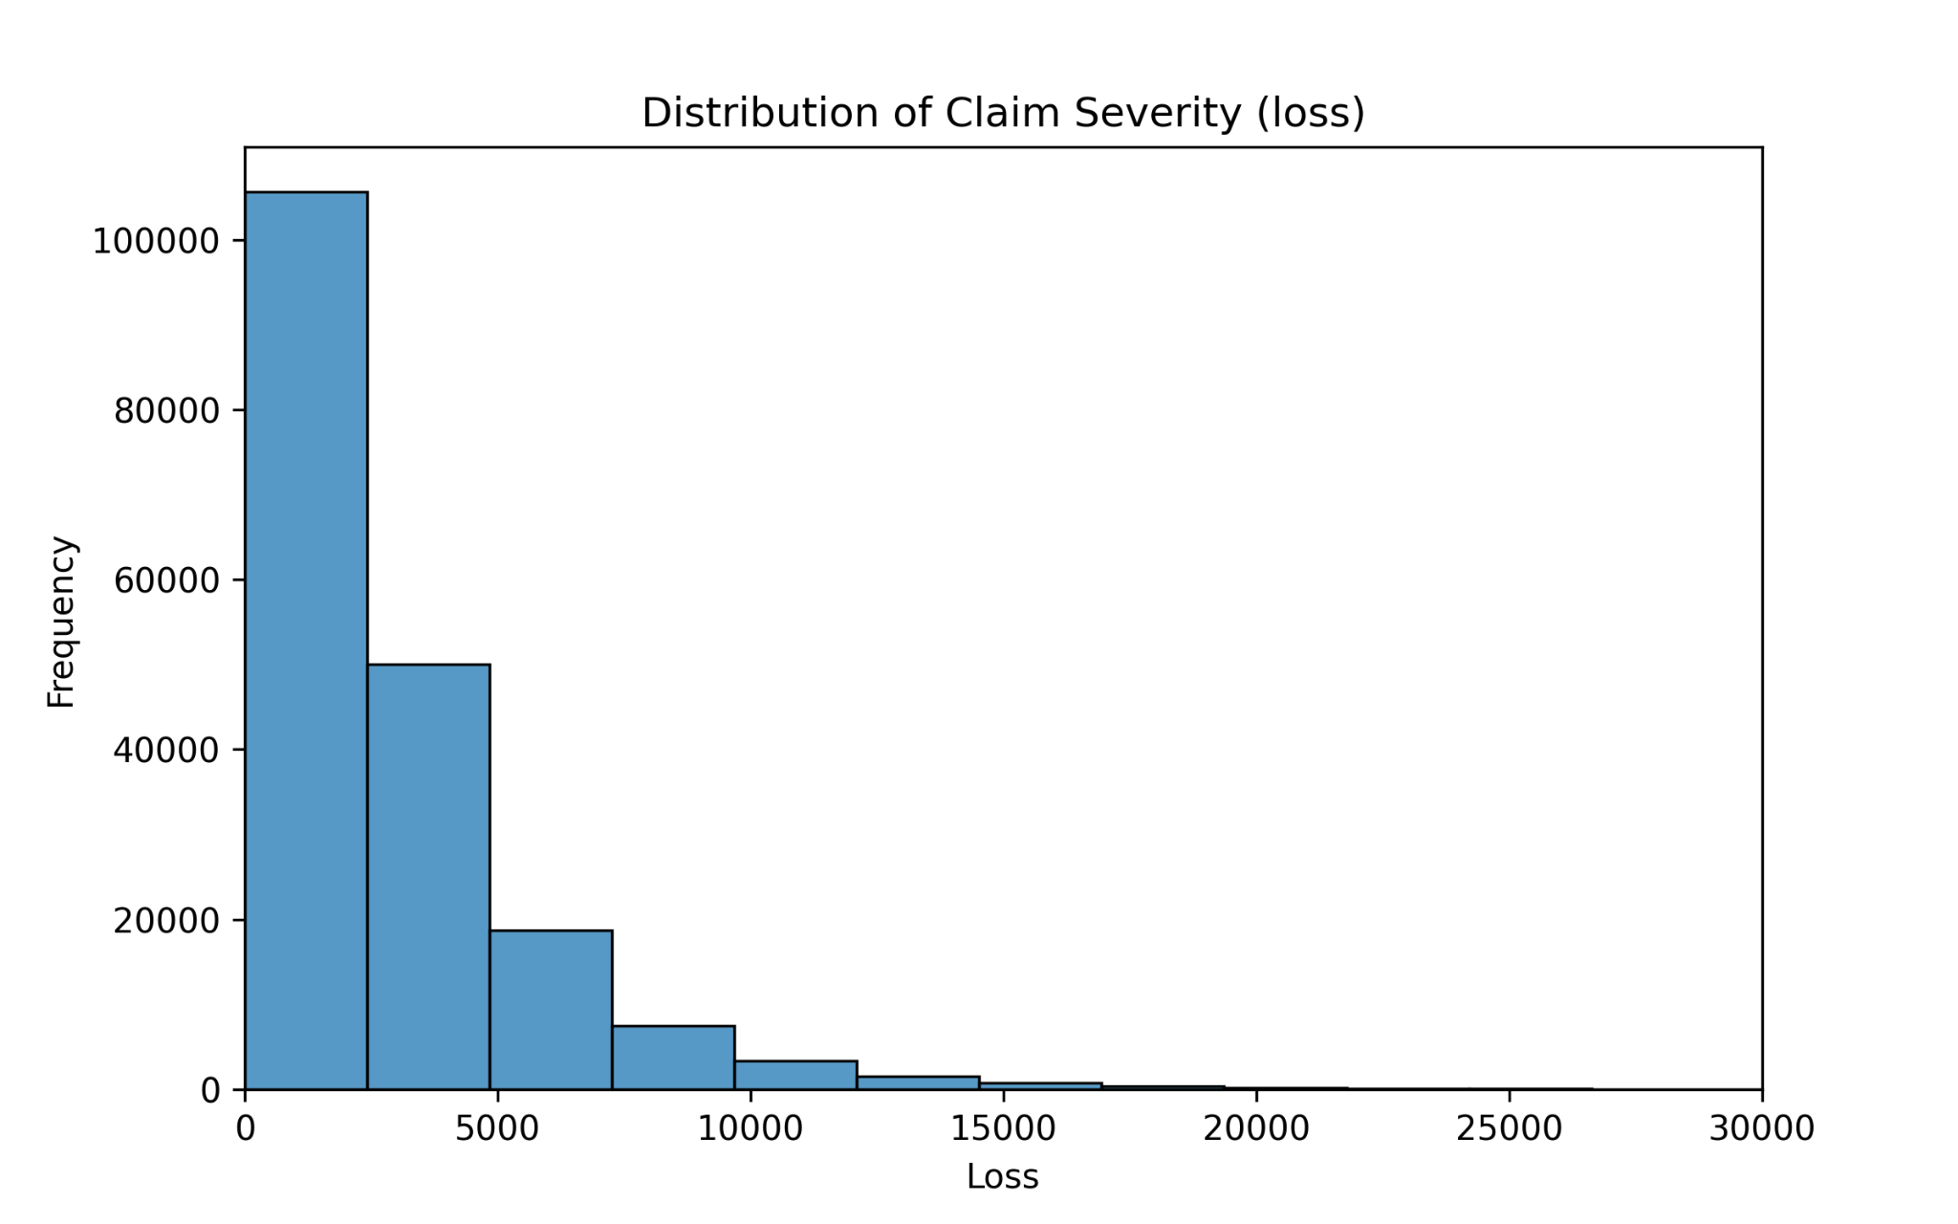
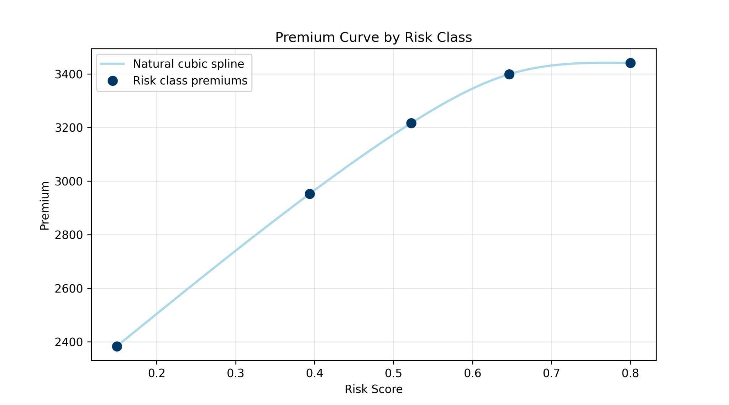
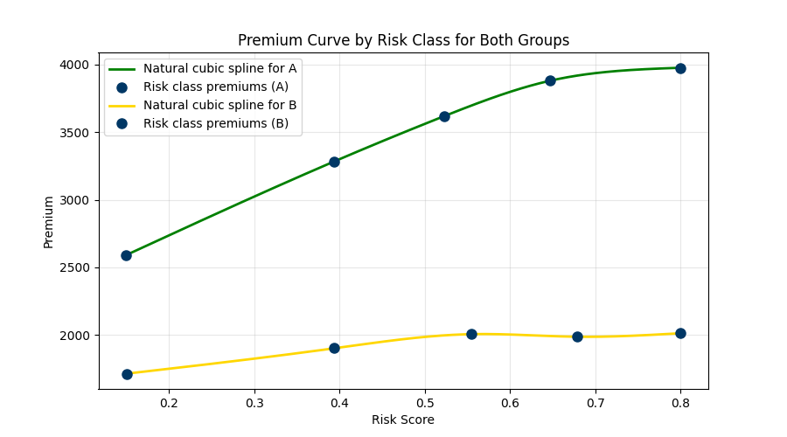
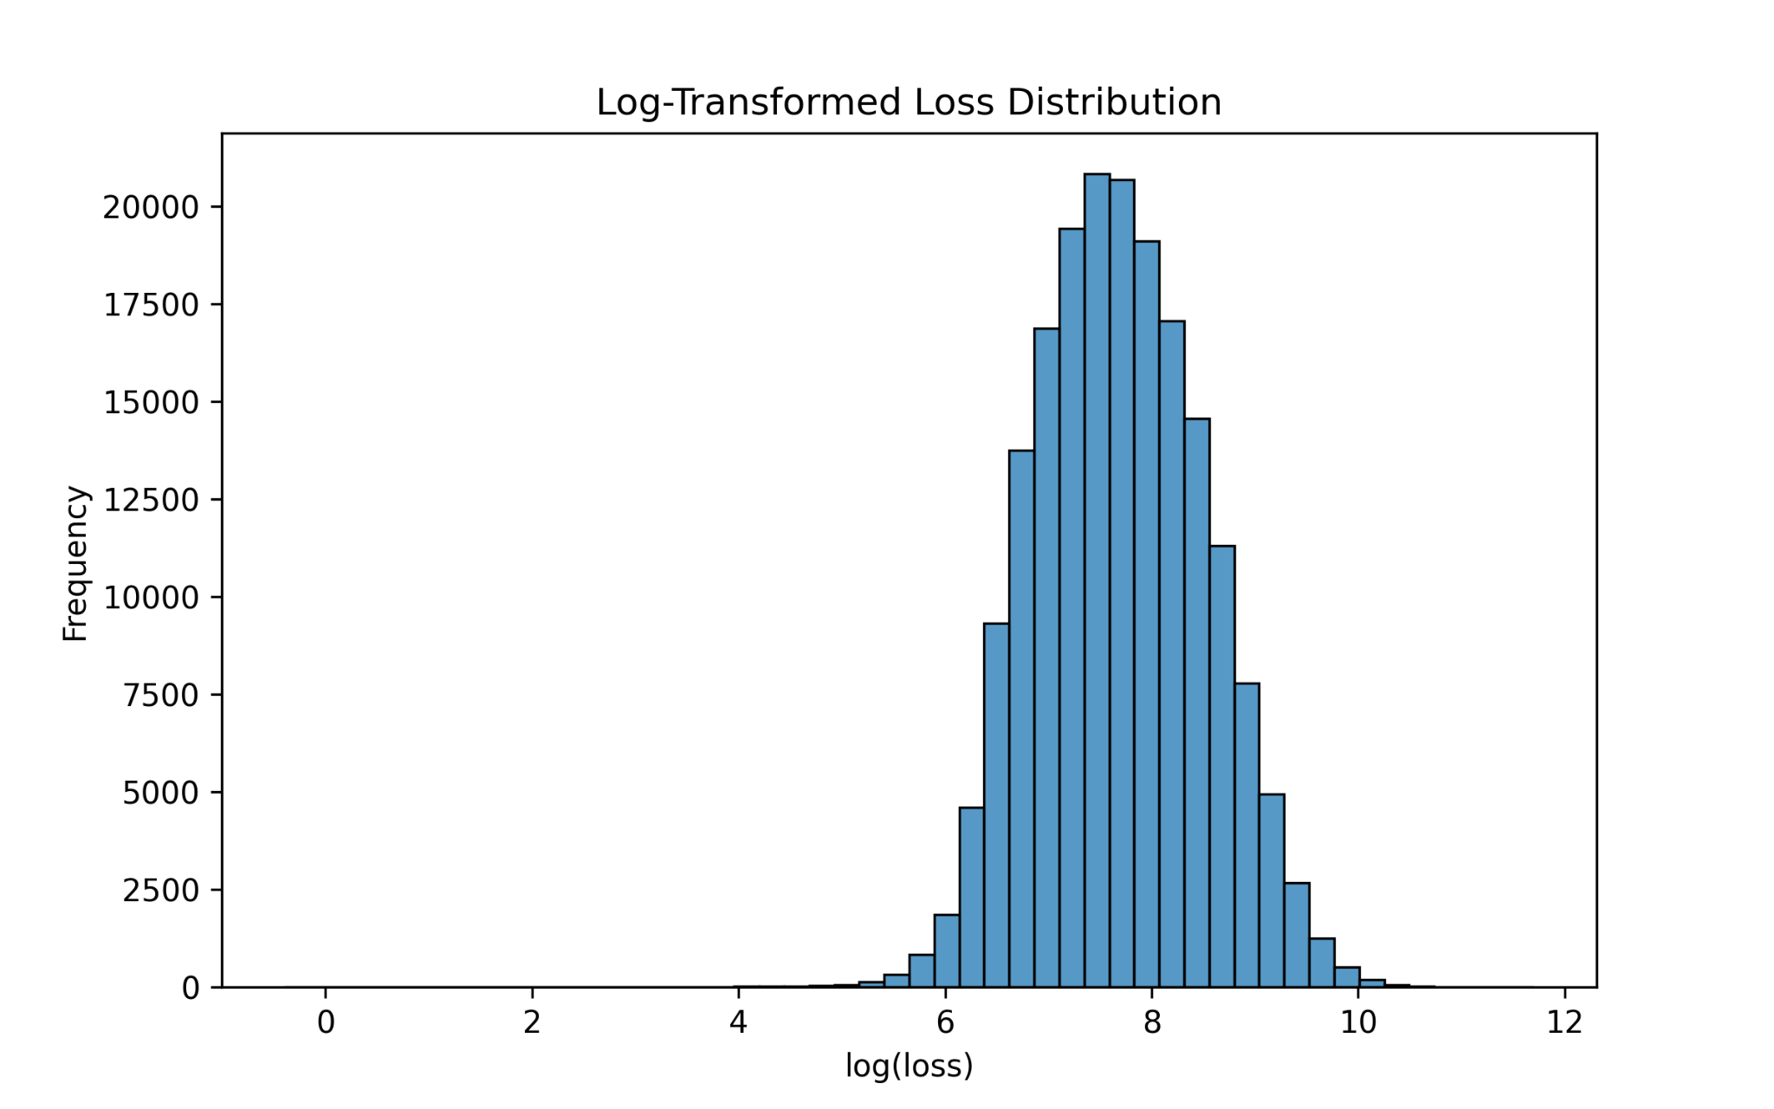
Estimating Insurance Loss Using Numerical Methods: A Comparison of Lognormal and Spline Models
Nathan Tassey and Patrick Lakomy - MATH 342 - Roger Williams University - Spring 2026
Introduction/ Problem
Numerical Methods
Solution Comparison
Insurance companies must estimate the expected loss per policy, E[X], to determine fair premiums
Real-world loss data are highly right-skewed, making analytical solutions difficult
This project uses numerical methods to approximate expected loss from real data
Multiple approaches are explored, including lognormal modeling, spline interpolation, and numerical integration
The goal is to compare methods and evaluate their effectiveness in estimating premiums
To get a proper estimate of the expected value of losses, three numerical methods were used. Each them was compared, to ensure we had an accurate model for the expected value.
E[X] ~ expected value, or expected loss for the insurance company
Method # | Name | E[X] Estimate
(1) | Newton’s Root Finding | 3025.49
(2a) | Full Cubic Spline | 3059.129
(2b) | Split Cubic Spline | 3059.917
(1) Newton’s Root Finding:
For a lognormal random variable: E[X] = e^{μ + 2σ^2}
Use Newton’s method to estimate σ (standard deviation) for Maximum Likelihood Expectation which states:
f(σ) = (1/n) Σ ( (xᵢ − μ)² / σ² ) − 1
Method States: σ(n) = σ(n-1) − f(σ(n-1)) / f′(σ(n-1))
Each time we get a new stdev (σ), we iteratively plug it into the above equation until a stable value is reached (repeated value)
Once the proper σ is reached we plug it back into E[X]
Solution:
σ = 0.8112
E[X] = 3025.49
Data
(2) Cubic Spline Model(s) + Numerical Integration:
Real-world insurance claims dataset (Allstate)
Focus on loss amount (claim severity)
Risk score used for spline modeling
Data are highly right-skewed
Log-transformed losses appear approximately normal
188,318 claims were collected
Both spline based methods following they same procedure:
Construct a natural cubic spline in which each spline is in the form of
Sᵢ(x) = aᵢ + bᵢ(x - xᵢ) + cᵢ(x - xᵢ)² + dᵢ(x - xᵢ)³
Each spline piece is construction based on an interval of our risk scores. Given that we split our risk scores into five bins, each full spline will have 4 distinct equations.
Then use numerical integration (Simpson’s ⅓ Composite Rule) to approximate E[X}
∫ₐᵇ f(x) dx ≈ (h/3)[ f(x₀) + 4Σ f(xᵢ) (odd i) + 2Σ f(xᵢ) (even i) + f(x(n)) ]
Conclusion
We applied multiple numerical methods to estimate expected insurance loss using both parametric and data-driven models. Root-finding, PDFs, and cubic splines all produced similar results, suggesting a stable and reliable estimate. This project highlights how theory and numerical methods are combined in real insurance loss modeling.
Histogram of Original Loss Data:
(2a) Full Cubic Spline:
Construct a Cubic Spline for population
find E[X] by:
E[X] = ( ∫ₐᵇ f(x) dx ) / (b − a)
a = minimum, b = maximum, f(x) = Spline
Assumptions
Losses follow a lognormal distribution.
Binning does not change the risk–loss relationship.
Each bin midpoint represents its data.
The cubic spline smoothly models the loss function.
Observations are independent and exposure is constant.
Solution:
E[X] = 3059.129
This histogram shows the distribution of positive claim loss amounts, or claim severities. Most are small, with few extreme outliers. This strong right skew indicates asymmetric data and motivates a lognormal model to capture the distribution of the losses
This graph shows the relationship between risk score and estimated premium using a cubic spline model. Each point represents the average premium with a risk class. The upward trend indicates a positive correlation between risk score and expected losses and therefore higher premiums
Drawbacks
Histogram of Lognormal Transformation:
The dataset is anonymized, limiting context
No exposure data, so frequency cannot be modeled
Binning leads to some loss of information.
Sparse bin data may cause spline overfitting.
Lognormal assumption may not capture tail risk
(2b) Split Cubic Spline:
Construct Two Cubic Splnes
One for group A and B
Find E[X] by:
E[X] = P(A)(∫ f(a)) + P(B)(∫ f(b))
Where B, A are different groups in data
This graph compares two cubic spline models fitted to group A and B. Each curve represents how premium varies with risk score within its group. The separation between curves suggests that different segments of the population may exhibit different risk-loss relationships, motivating the use of segmented modeling.
References
Solution:
E[X] = 3059.917
https://towardsdatascience.com/log-normal-distribution-a-simple-explanation-7605864fb67c/
https://docs.scipy.org/doc/scipy/reference/generated/scipy.interpolate.CubicSpline.html
https://www.itl.nist.gov/div898/handbook/eda/section3/eda3669.htm
https://mathworld.wolfram.com/LogNormalDistribution.html
https://docs.scipy.org/doc/scipy/reference/generated/scipy.optimize.newton.html
https://www.kaggle.com/competitions/allstate-claims-severity
This histogram displays the log-transformed loss data. After applying a logarithmic transformation, we get a bell-shaped normal distribution. This indicates that the data can be modeled using a lognormal distribution.

